Slide 2
Fresh Fruit or Rotten Fruit Classification Using Deep Learning
MINOR PROJECT I END-TERM PRESENTATION
SUBMITTED BY:-
Rohit Kumar - R214220968
Ananya Dutta - R214220145
MENTORED BY:-
Dr. Hitesh Kumar Sharma

Slide 3
Abstract
Detecting the rotten fruits have become significant in the agricultural industry. Usually, the classification of fresh and rotten fruits carried by humans is not efficient. If we do not detect the defected fruits, it may contaminate the fresh ones. The proposed model can perceive fresh and rotten fruits using inputs in the form of photograph data and help avoid the spread of rottenness. Precisely, we have used three types of fruits, such as apple, banana, and oranges. The project aims to increase the probability of supplying quality fruits, reduce human efforts, cost, and time for production by identifying the defects in the fruits. A Convolutional Neural Network (CNN) model is trained and used for extracting the features from input fruit images, and further classifying them. The performance of the model is evaluated on a Kaggle dataset. The results showed that the proposed CNN model can classify the fresh and rotten fruits with an efficiency greater than 95%.

Slide 4
Introduction
Currently, AI is the buzzing term for the decade with its major contribution coming from Deep Learning. Thus, it becomes crucial to understand the basics of deep learning as they are changing the world we live in for the greater good. Speaking of Deep Learning, it is a sub-field of machine learning that deals with algorithms truly inspired by the structure and functions of a human brain.
India is one of the paramount fruit producers in the world. In the Indian agricultural sector, it is a huge problem to identify defective fruits and classify fruits as fresh or rotten. Since, it is quite difficult for industrial people to classify fruit quality using conventional methods, fruit classification needs new tools and techniques based on image processing. In order to identify the quality of fruits being supplied, we use a type of artificial neural network called Convolutional Neural Network (CNN). It is a part of Deep Learning which is widely used for image recognition & classification. In simpler words, Deep Learning makes use of CNN to identify objects present in an image.

Slide 5
Objectives
Obtain relevant dataset for training and testing of our model to be built.
Build a model to classify fresh fruits from rotten fruits using image inputs.
Build and train a Convolutional Neural Network (CNN) model and use it for extracting the features from input fruit images and further classify them.
Compare, contrast and analyse the results provided by our model.

Slide 6
Methodology
A deep study of various species of apple, banana and orange.
Analysis and classification of fruit species to determine the fresh and rotten ones among them.
Selection of dataset including numerous images of fruits.
Loading of data.
Pre-processing of data.
To implement this model , python will be used along with machine learning algorithms.
Training of the model.
Testing and improvisation of the model.

Slide 7



Tools and Technologies
Kaggle: Kaggle is a website for sharing ideas, getting inspired, competing against other data scientists, learning new information and coding tricks, as well as seeing various examples of real-world data science applications.
Python 3: Libraries like NumPy, and matplotlib make it very capable of processing, manipulating, and visualizing data — which is why it’s favored in data analysis.
Google Colab: Colaboratory, or “Colab” for short, is a product from Google Research. Colab allows anybody to write and execute arbitrary python code through the browser, and is especially well suited to machine learning, data analysis and education. More technically, Colab is a hosted Jupyter notebook service that requires no setup to use, while providing access free of charge to computing resources including GPUs.

Slide 8
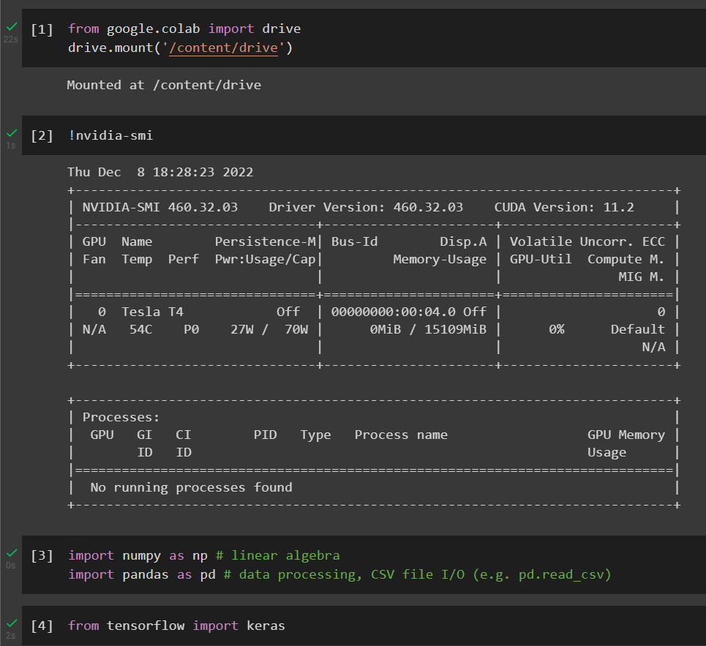
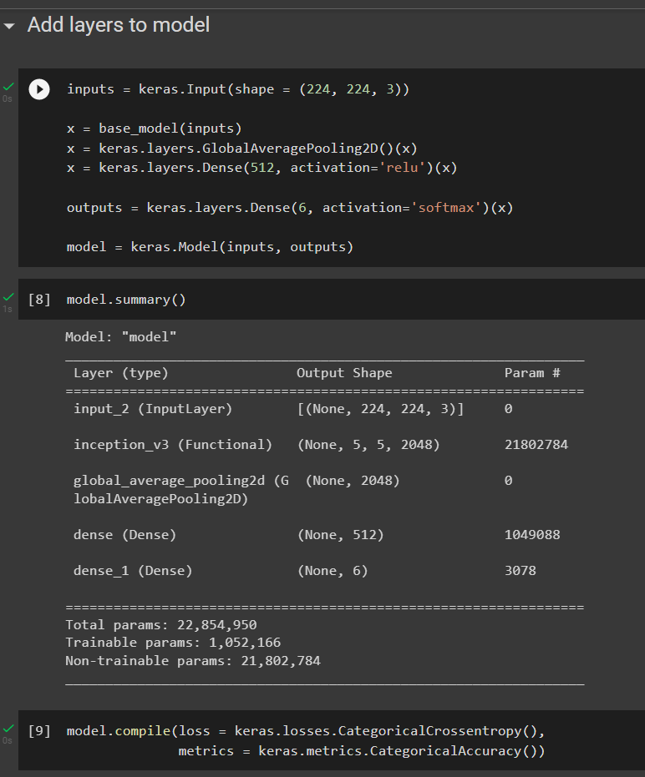
Screenshots

Slide 9
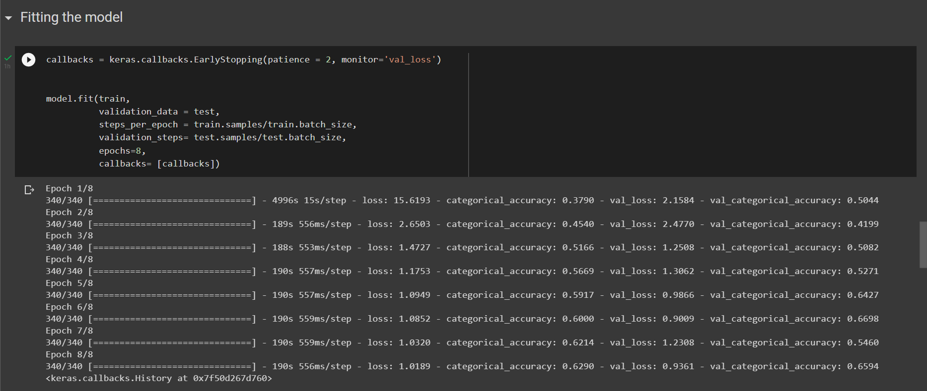
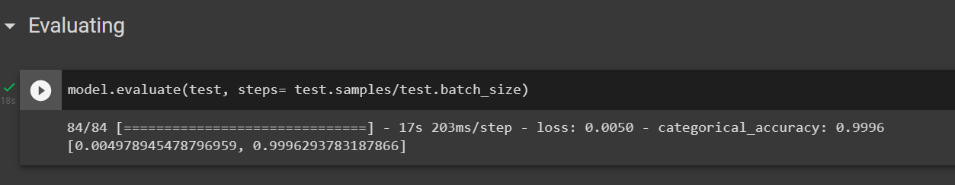
Screenshots(Continued)

Slide 10
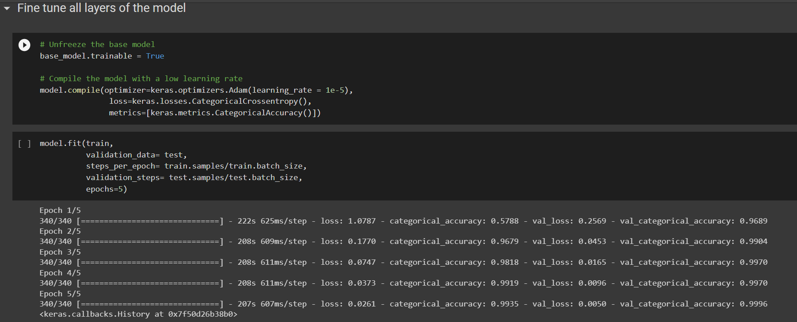
Screenshots(Continued)

Slide 11
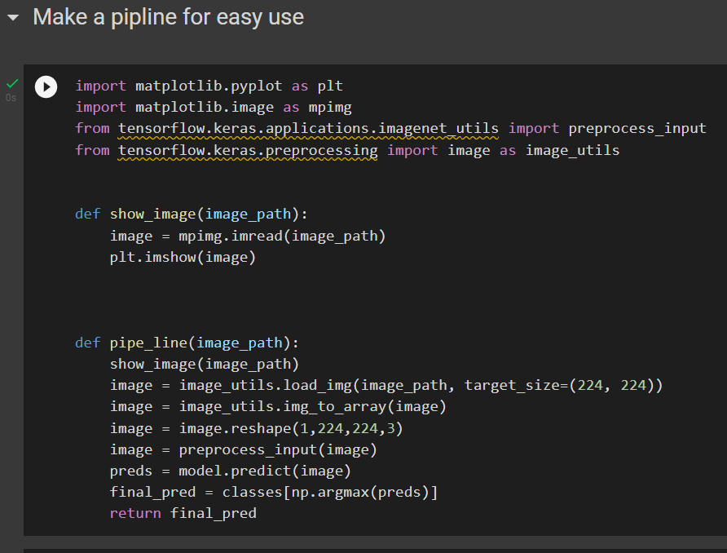
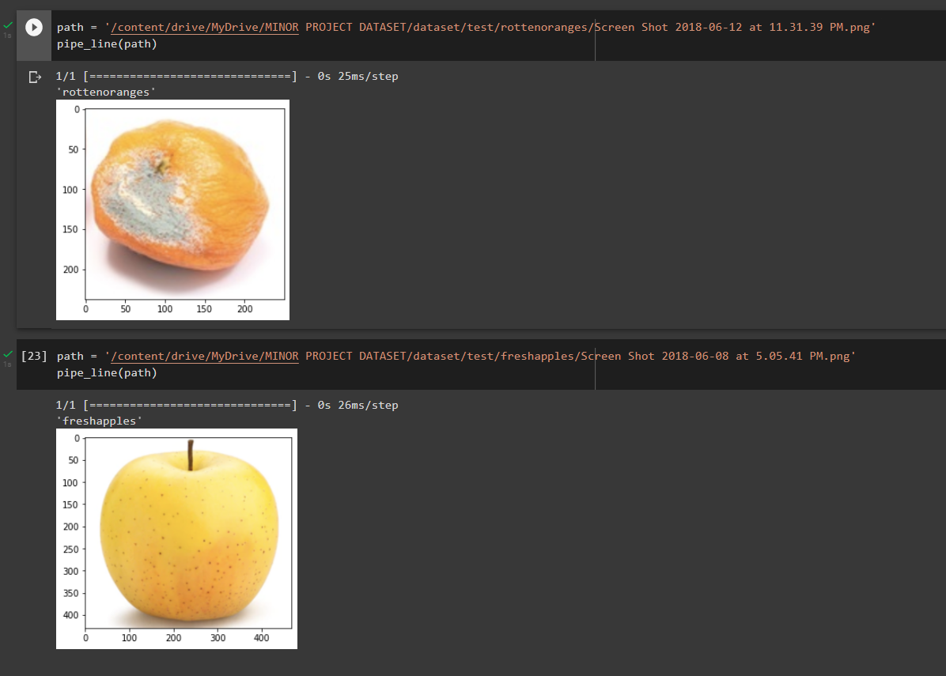
Screenshots(Continued)

Slide 12
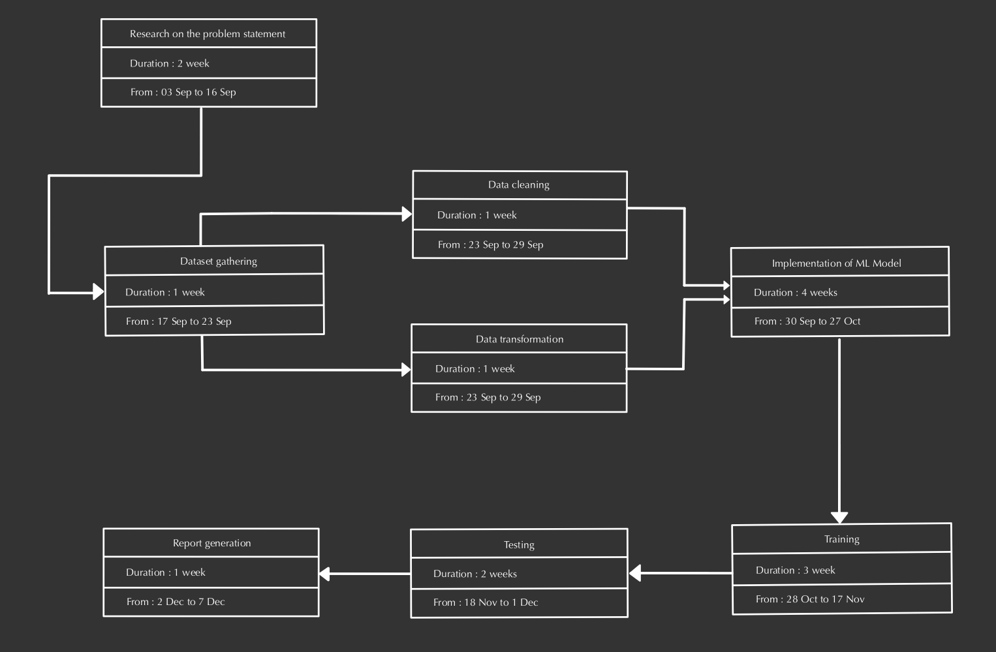
Pert Chart

Slide 13
References
https://www.kaggle.com/datasets/sriramr/fruits-fresh-and-rotten-for-classification
https://www.ibm.com/cloud/learn/deep-learning
https://www.ibm.com/cloud/learn/convolutional-neural-networks
https://www.youtube.com/watch?v=zfiSAzpy9NM
https://ieeexplore.ieee.org/document/8946385

